Slide 1
Contact Book System
Lizbeth Sanchez
COP 2006 – Programming 1
Crn 15620 – Prof. Michael Osheroff

Slide 2
Goal and Software Requirements
My goal for this project is too be able to find a way to add a new organization material to the original code and practicing all I’ve learned to apply it for a task that is used on a daily basis.
CLion

Slide 3
Why I chose this Project Added Concept
I chose this project concept because I wanted to combine something I learned this semester with something that I could use daily.
I wanted to be part of project that I know I could understand and was within my abilities and knowledge.
The original code only had four options to chose, so I added a 5th option to “look up” certain contacts added in the user’s system.

Slide 4
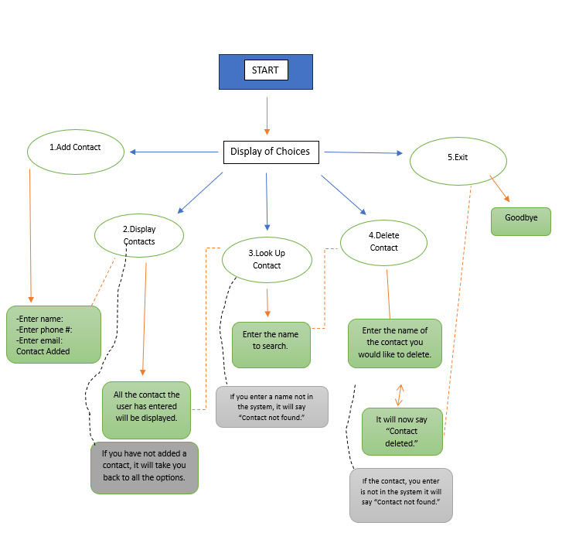
FlowChart

Slide 5
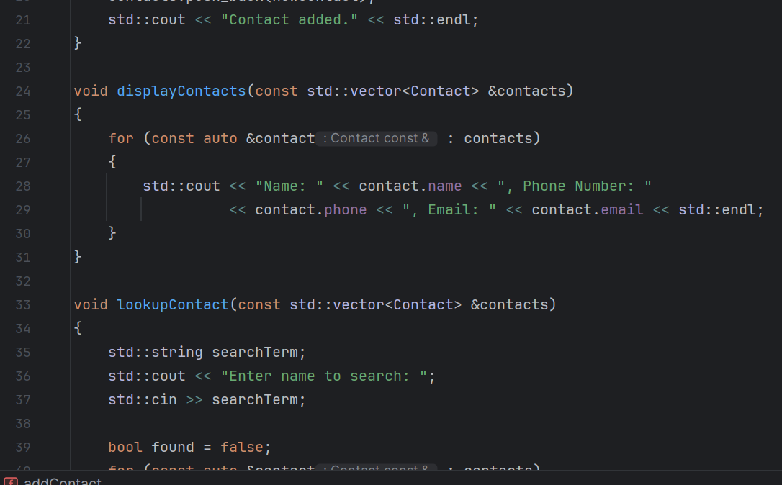
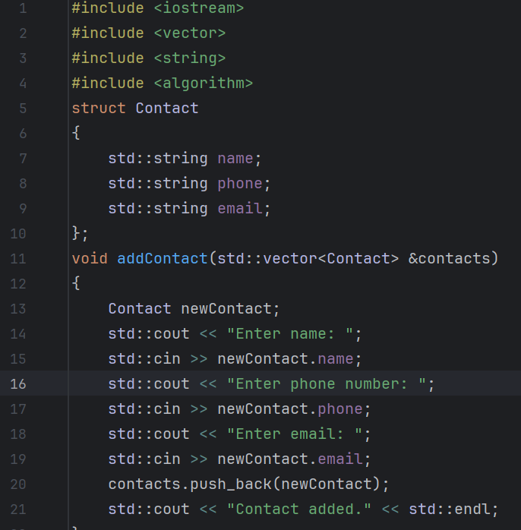
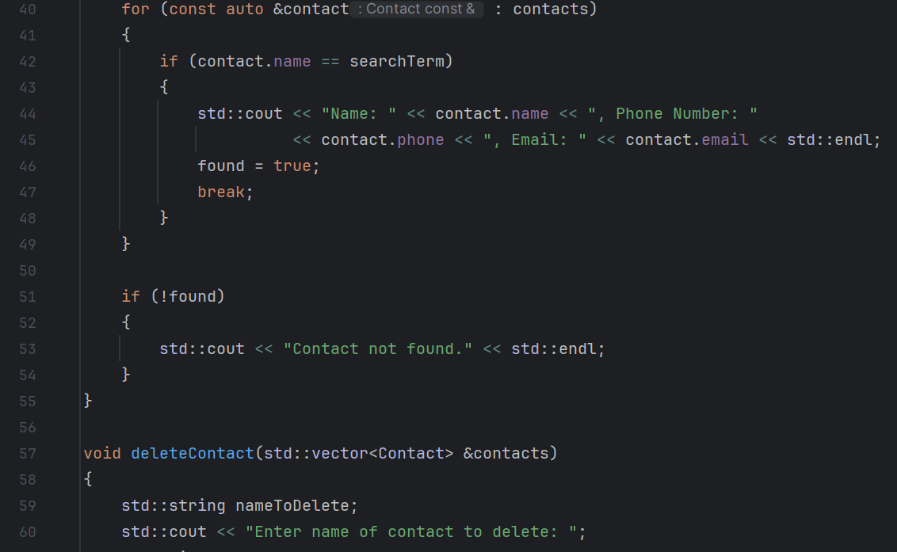
Screenshots of Code

Slide 6
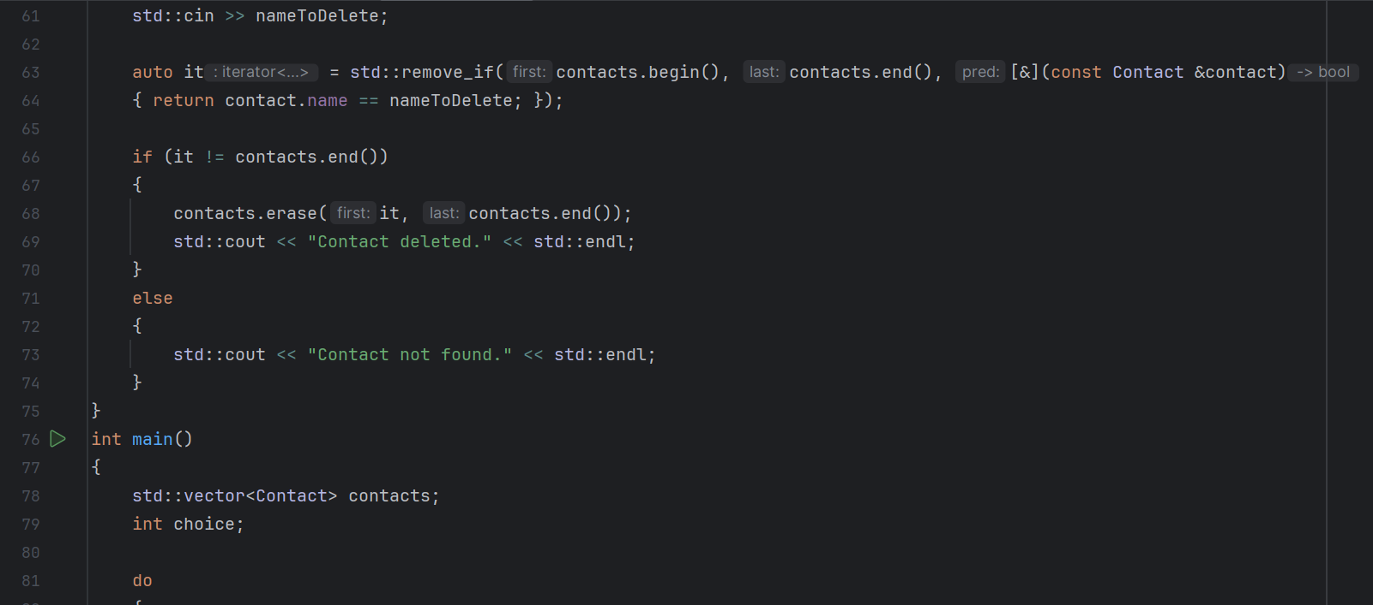
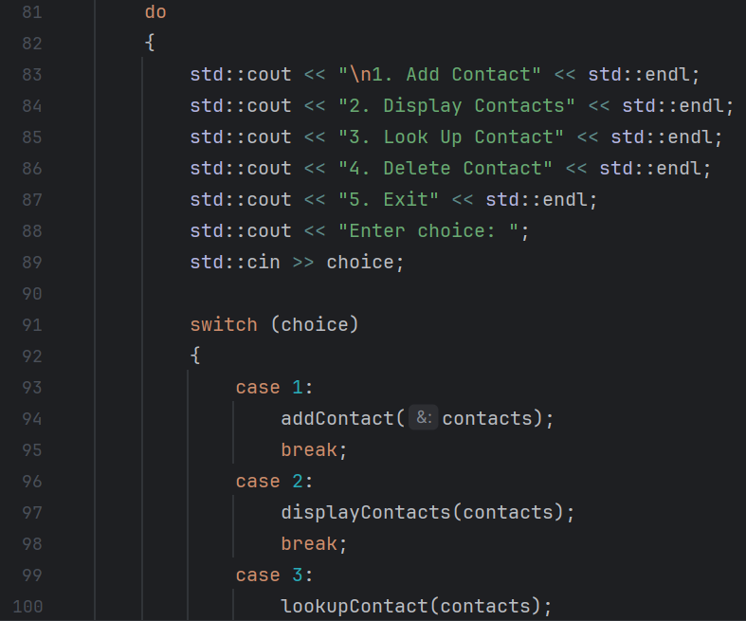
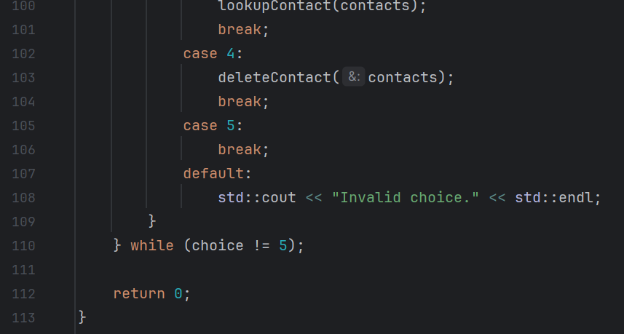
More Screenshots

Slide 7
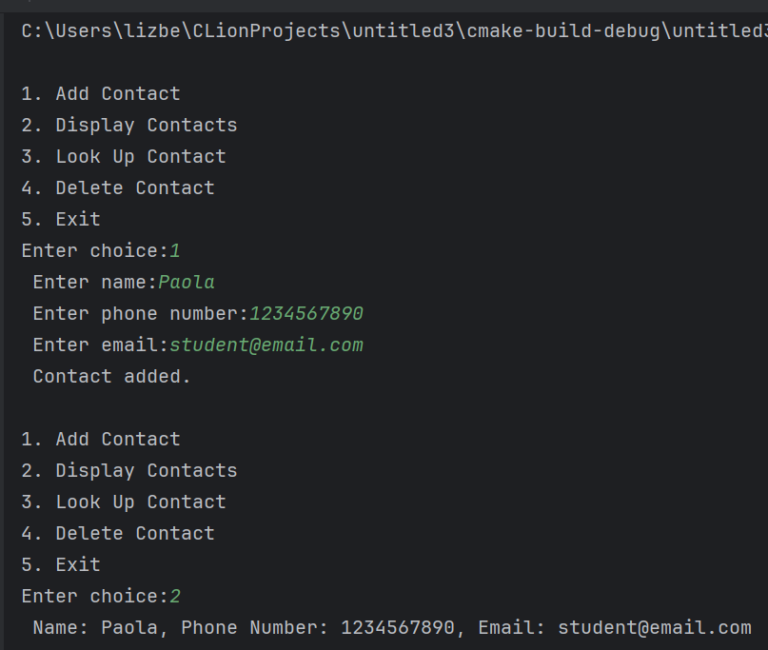
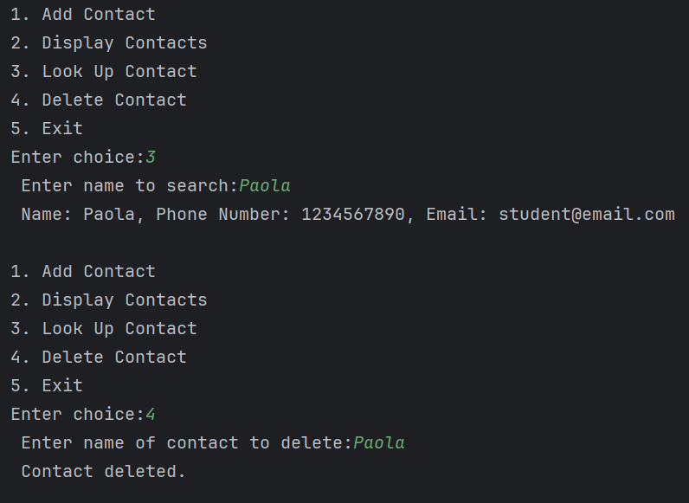
Outputs

Slide 8
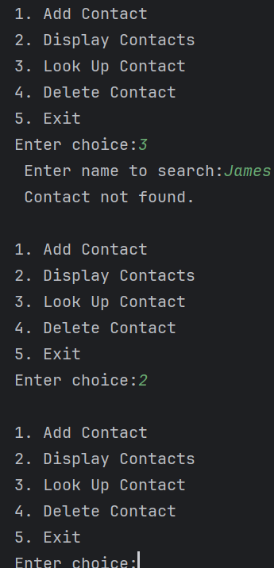
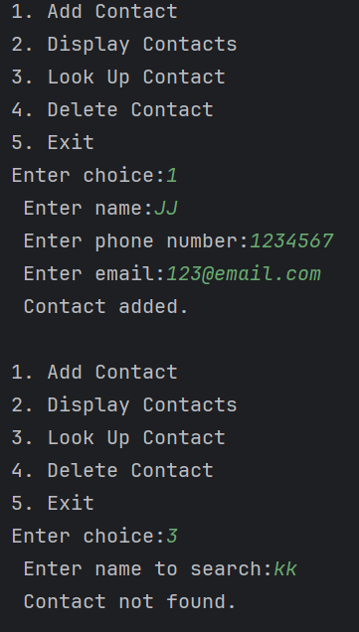
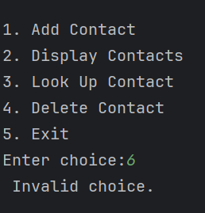
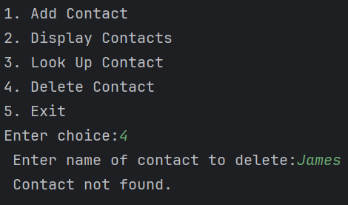
Continued Outputs

Slide 9
Resources
Contact Management System - C++ Project (youtube.com)
Find the best online Programming courses and Tutorials - Hackr.io

